Slide 1
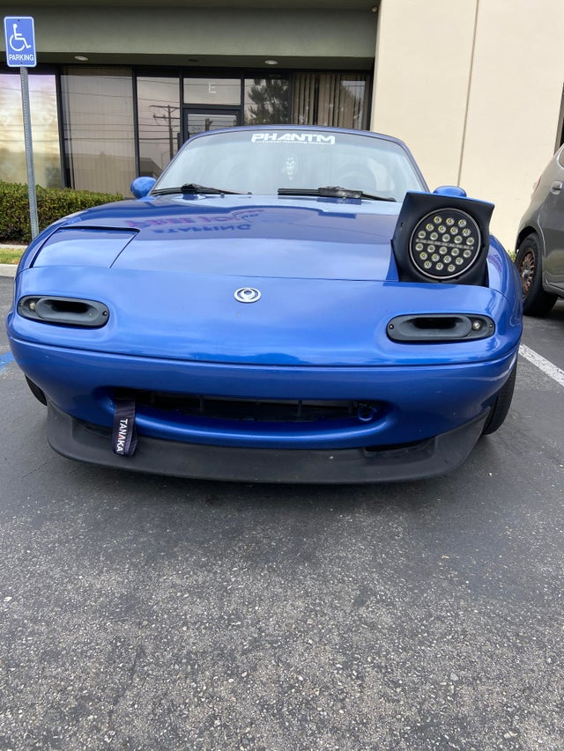


V2V Vehicles Identification
Hey, it’s me
McQueen
Doc Hudson
Hicks
FLO

Slide 2
Along with timestamp, Vehicle identification is a very essential and critical information to share whenever a payload from a vehicle is being shared with other vehicles.
In our current implementation during testing process, we have used MAC address of the ESP-32/8266 module (DSRC alternative) as vehicles unique identifier (which may not be sufficient in real world use)
Each vehicle has a ESP-32/8266 module, Assuming no-repeated MAC addresses (unreliable but sufficient for development processes), each vehicle can compare the MAC address of each payload sender to identify if it’s a new vehicle or an already seen vehicle

Slide 3
For new vehicles, A new vehicle structure is created for this vehicle with a timer for removal in case of absence of updated data for a certain amount of time (no signal coverage means long enough distance to neglect this vehicle) this vehicles data structure will be removed.
When receiving a payload from an already seen vehicle and timeout period has not yet been exceeded (MAC address and vehicle’s data still in memory), this vehicle’s data is then updated for sharing with the ECU (Raspberry pi through SPI) to take informed decisions when needed

